Slide 1
Definición del Perfil – IEC 62056 DLMS/COSEM
ENEL

Slide 2



Definición del Perfil – IEC 62056 DLMS/COSEM
Referencias:
ANEXO TECNICO SISTEMAS DE MEDICIÓN, MONITOREO Y CONTROL
IEC 62056
Experiencias internacionales de definición de modelo datos
Great Britain
PUBLICLY HELD COMPANY “ROSSIYSKIYE SETI”

Slide 3
Definición del Perfil – IEC 62056 DLMS/COSEM
Macro Arquitectura
Measurands Objects
Energy Profile Objects
Energy Objects
Maximum demand profile (PMD) Object
Instantaneous Energy Objects
Daily Energies Object
Load Consumption Objects
Power Objects
Energy Billing profile Object
Instantaneous Power Objects
Average Power Objects
Security Objects
Maximum Power Objects
Security Setup Object
Manage Events Objects
Security Suite ID 0
Event Log Object

Slide 4
Listado de Objectos 1/2: Measurands Objects
Energy Objects
Instantaneous Energy Objects
Load Consumption
Average Power Objects
Maximum Power Objects
Instantaneous Power Objects

Slide 5
Listado de Objectos 2/2: Energy Profile Objects
Maximum Demand Profile (PMD) Objects
Daily Energies Objects
Billing Profile Object
Capture object
Capture object
Capture object

Slide 6
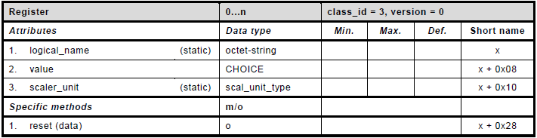
Measurands Objects
IEC 62056 DLMS/COSEM
Energy Objects
Instantaneous Energy Objects
Ejemplo
DLMS Register

Slide 7
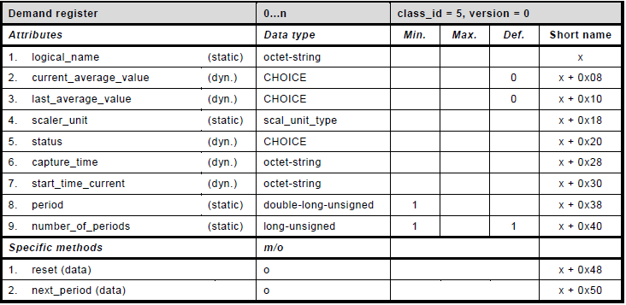
Measurands Objects
IEC 62056 DLMS/COSEM
Power Objects
Average Power Objects
Ejemplo
DLMS Demand Register

Slide 8
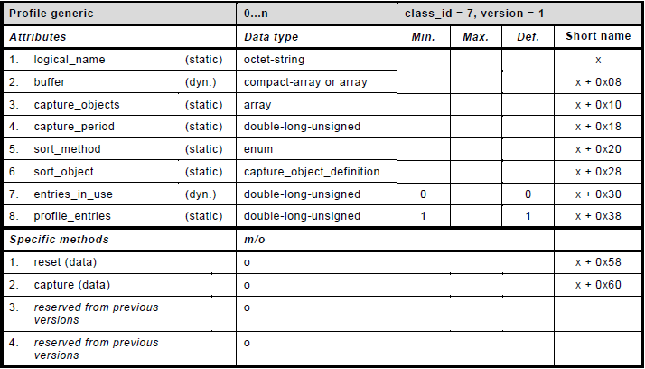
Energy Profile Object
IEC 62056 DLMS/COSEM
Energy Billing profile Object
Ejemplo
DLMS Profile Generic

